Slide 1
Serverless Computation with OpenLambda
Functions as a Service Team

Slide 2
Outline
Introduction & Background -- Lian
Container to Serverless -- Zhuyu
Limitation of Serverless Computing -- Yuhang
Future of Serverless Computing -- Yuxuan
Conclusion and Comments -- Lian

Slide 3
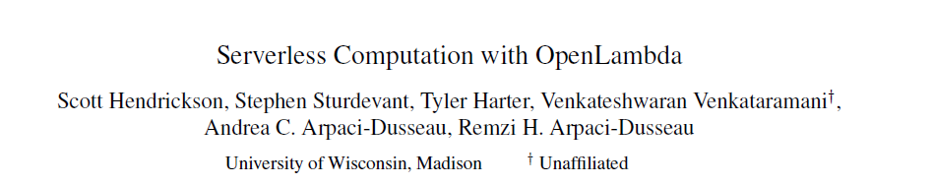
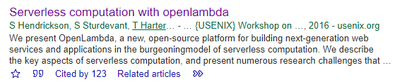
2016 paper
UW Madison

Slide 4
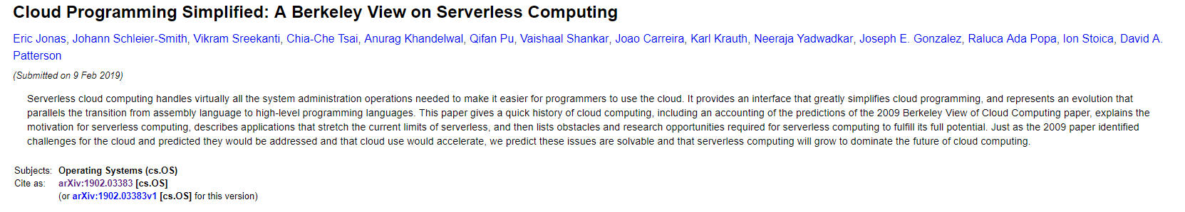
Berkeley Paper

Slide 5
Cloud Computing Development
Early days -- users want to recreate SAME computing environments
Drawback : need to manage virtual machines by user
Amazon -- 2014 AWS Lambda
Offer cloud functions
Topic : Serverless Computing

Slide 6
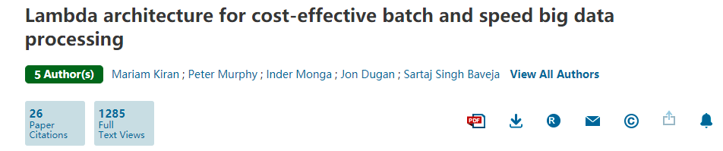
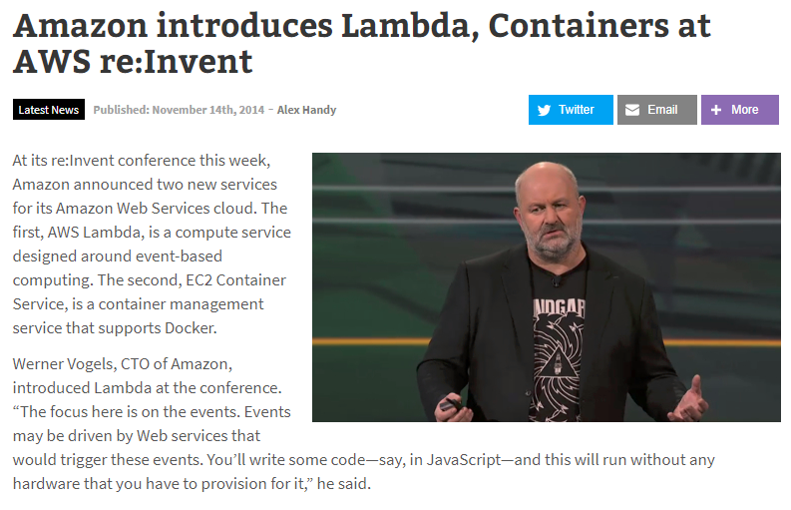
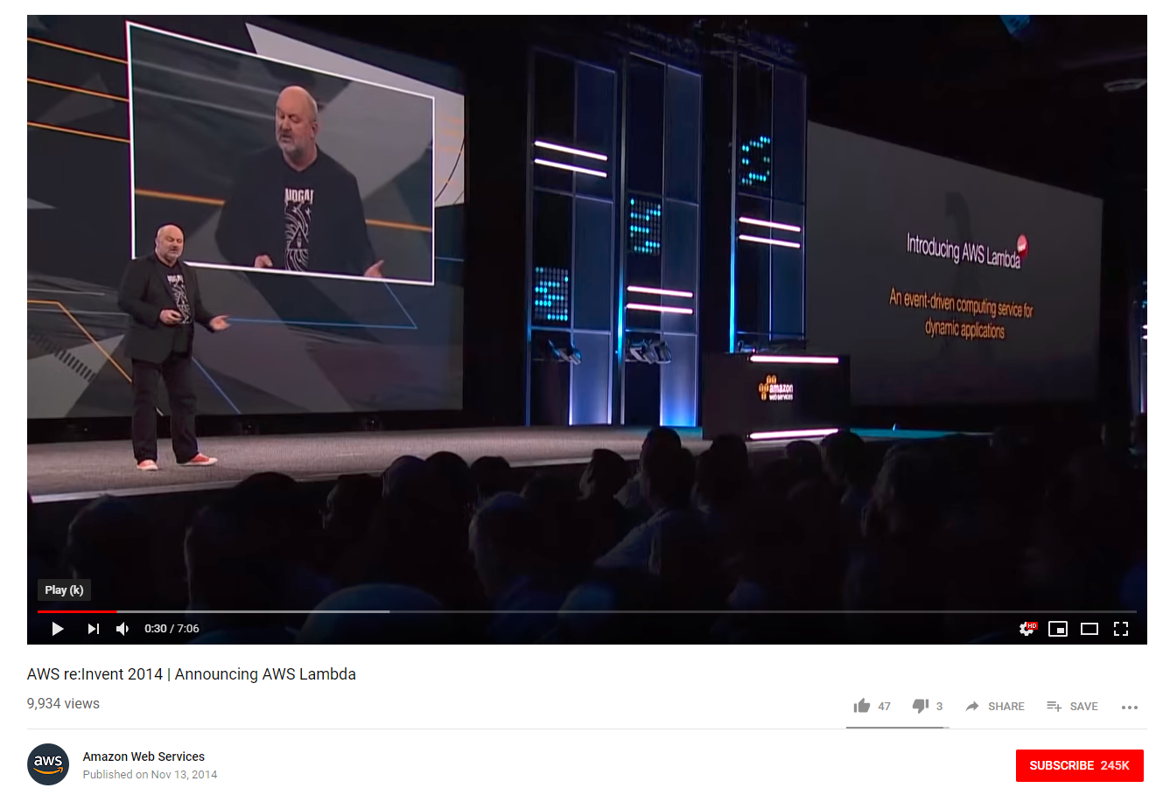
AWS Lambda
Academic vs Commercial

Slide 7
What is Serverless Computing
Cloud provider runs the server, and dynamically manages the allocation of machine resources. Pricing is based on the actual amount of resources consumed by an application, rather than on pre-purchased units of capacity.
Really serverless?

Slide 8
What is Serverless Computing
Berkeley Paper:
“While cloud functions—packaged as FaaS (Function as a Service) offerings—represent the core of serverless computing, cloud platforms also provide specialized serverless frameworks that cater to specific application requirements as BaaS (Backend as a Service) offerings. Put simply, serverless computing = FaaS + BaaS”
“In our definition, for a service to be considered serverless, it must scale automatically with no need for explicit provisioning, and be billed based on usage.”

Slide 9
What is Serverless Computing
Berkeley Paper:
“user just writes a cloud function in a high-level language, picks the event that should trigger the running of the function—such as loading an image into cloud storage or adding an image thumbnail to a database table—and lets the serverless system handle everything else”

Slide 10
Outline Revisited
Introduction & Background -- Lian
Container to Serverless -- Zhuyu
Limitation of Serverless Computing -- Yuhang
Future of Serverless Computing -- Yuxuan
Conclusion and Comments -- Lian

Slide 11
Paper: Serverless Computation with OpenLambda
Present OpenLambda
New open source platform
‘Lambda Model’
Structure analysis
Research Agenda
9 different aspects exploration

Slide 12
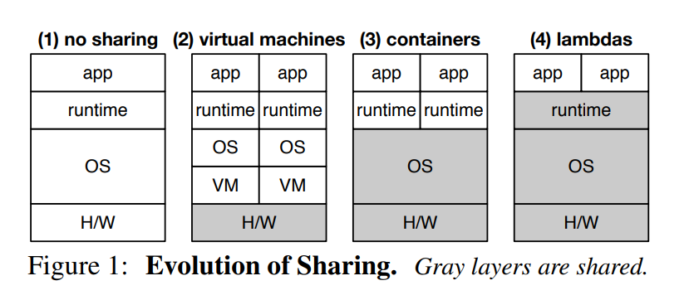

Slide 13
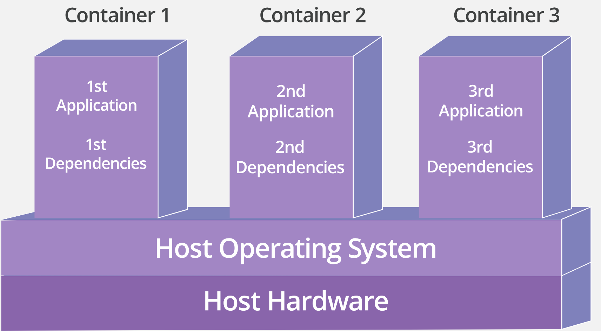
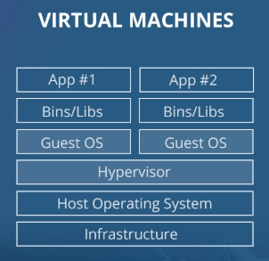
VM & Container
Imitates a complete computer system
Improve utilization of the hardware
Take up a lot of system resources
Deployment on top of host operating system
Pack the application with all its dependencies
Portable, consistent operating environment
Notes:
VM: operating systems share hardware
adds overhead in memory and storage
Pack: binaries libraries
create a container that will include an immutable runtime environment for your application as well the application code.

Slide 14
Container: Advantage
Less resource intensive
Add more computing workload
Less time provisioning
Run the same way no matter where it is hosted
Container share the machine’s kernel with other containers but runs as if it is the only system on the machine
Flexible
Easy to set up or destroy
Notes:
In practice, You can put two to three times as many as applications on a single server with containers than you can with a VM
Severless scale up on containers
create a container that will include an immutable runtime environment for your application as well the application code.

Slide 15
Container: Weakness
Startup time
80% of time spent on package installation
Still need several seconds startup time
Scale up
In a container-based architecture, developer determines the number of containers deployed
Slow scaling
Low efficiency for some miniservice
Pay for running cost

Slide 16
Serverless: Overview
Split application into different functions (service)
Triggered by events
Fast auto-scaling
Pay as you go
Only pay for execution time

Slide 17
Difference: Serverless and Container
Physical machines
Container: each container lives on one specific machine at a time
Serverless: no specific machine is assigned for a given function or application
Scalability
Container: the number of containers deployed is determined by the developer in advance.
Serverless: the backend inherently and automatically scales to meet demand (Auto-scaling).
Deployment time
Container: necessary to configure system setting, libraries.
A few seconds to deploy
Serverless: live as soon as the code is uploaded
Do not come bundled with system dependencies
Notes:
Implementation

Slide 18
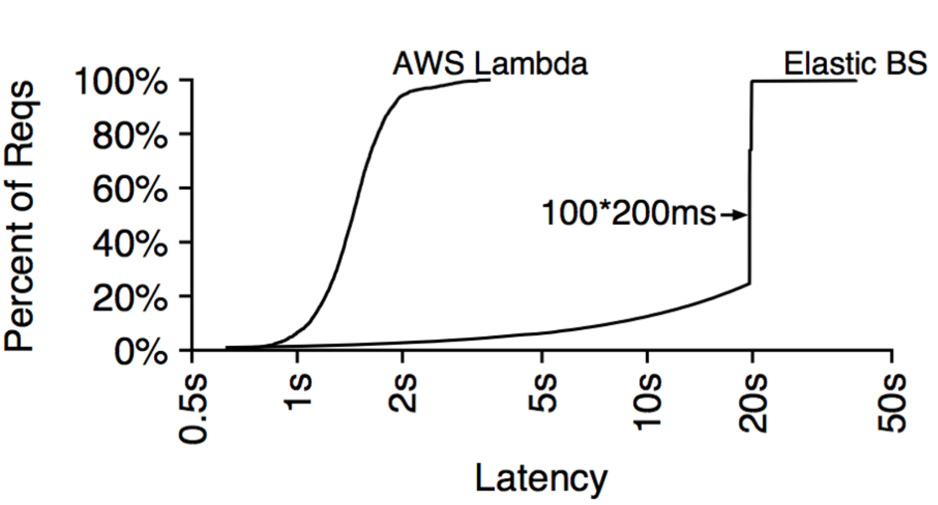
Container and Serverless: Performance
Short Burst Simulation:
Maintain 100 concurrent requests
Use 200ms of compute per request
Experiment on Amazon Elastic BS
Autoscaling cloud service
Build application as containerized servers, service RPCs
Experiment on Lambda
Elastic Beanstalk does not scale quickly enough to handle load burst
Lambdas are highly elastic

Slide 19
Serverless: Sharing Runtime
Reuse same container for same function
Benefit: save container startup time
Several seconds set up a container but several milliseconds to compute a function
Keep container running instead of turning it down
Different user can’t use same container
Current state of art. Never use a container between two different users
Security reason
Http Req
User:A
Func: f(x)
C1: f()
f(x)
Http Req
User: A
Func: f(x)
C1: f()
f(x)
C1: f()
C1: f()
Http Req
User:A
Func: f(y)
C1: f()
f(y)
Http Req
User: B
Func: f(x)
C2: f()
f(x)
Notes:
The paper emphasizes the sharing of runtime when talking about evolution from container to serverless but doesn't provide detailed description, figure out how that sharing works and difference between them

Slide 20
Serverless: Sharing Runtime
Deal with functions asynchronously
Latency for concurrent requests
Trade-off for datacenter
Processing time: Cold Start + Execution
Consuming memory
Pay by user
Cause latency
Set up new container
Pay by vendor
Less latency
Notes:
Response for the last request
serially

Slide 21
Serveless Limitation

Slide 22
Inadequate storage for fine-grained operations
Lack of fine-grained coordination
Poor performance for standard communication patterns
Unpredictable Performance

Slide 23
Inadequate Storage
(1) Object storage services: AWS S3, Azure Blob Storage, Google Cloud Storage
High access costs - $30/min to sustain 100K IOPS(S3)
High latency - 10 ~ 20 ms
(2) Key-value databases: AWS DynamoDB, Google Cloud Datastore, Azure Cosmos DB
High IOPS but expensive
Long time to scale up
(3) In-memory storage: AWS ElastiCache, Google Cloud Memorystore
Not fault tolerant
Not autoscale as do serverless computing platforms

Slide 24
Lack of coordination
We need to provide a way for tasks to coordinate.
Imagine there two tasks A and B in serverless platform. If task A relies on B’s output, we need to provide for A to know when the output is available.
Solutions:
(1) AWS Lambda - SNS and SQS
(2) Manage a VM-based system that provides notifications
(3) Implement your own notification mechanism

Slide 25
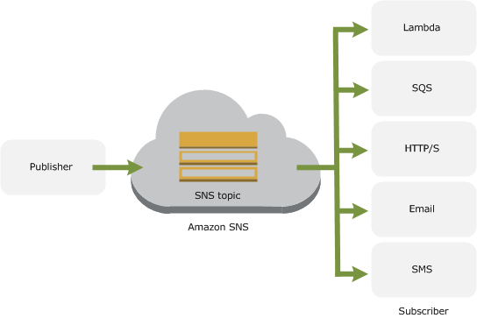
AWS SNS and SQS
SNS: SNS is a distributed publish-subscribe system. Messages are pushed to subscribers as and when they are sent by publishers to SNS.
SQS: SQS is distributed queuing system.

Slide 26
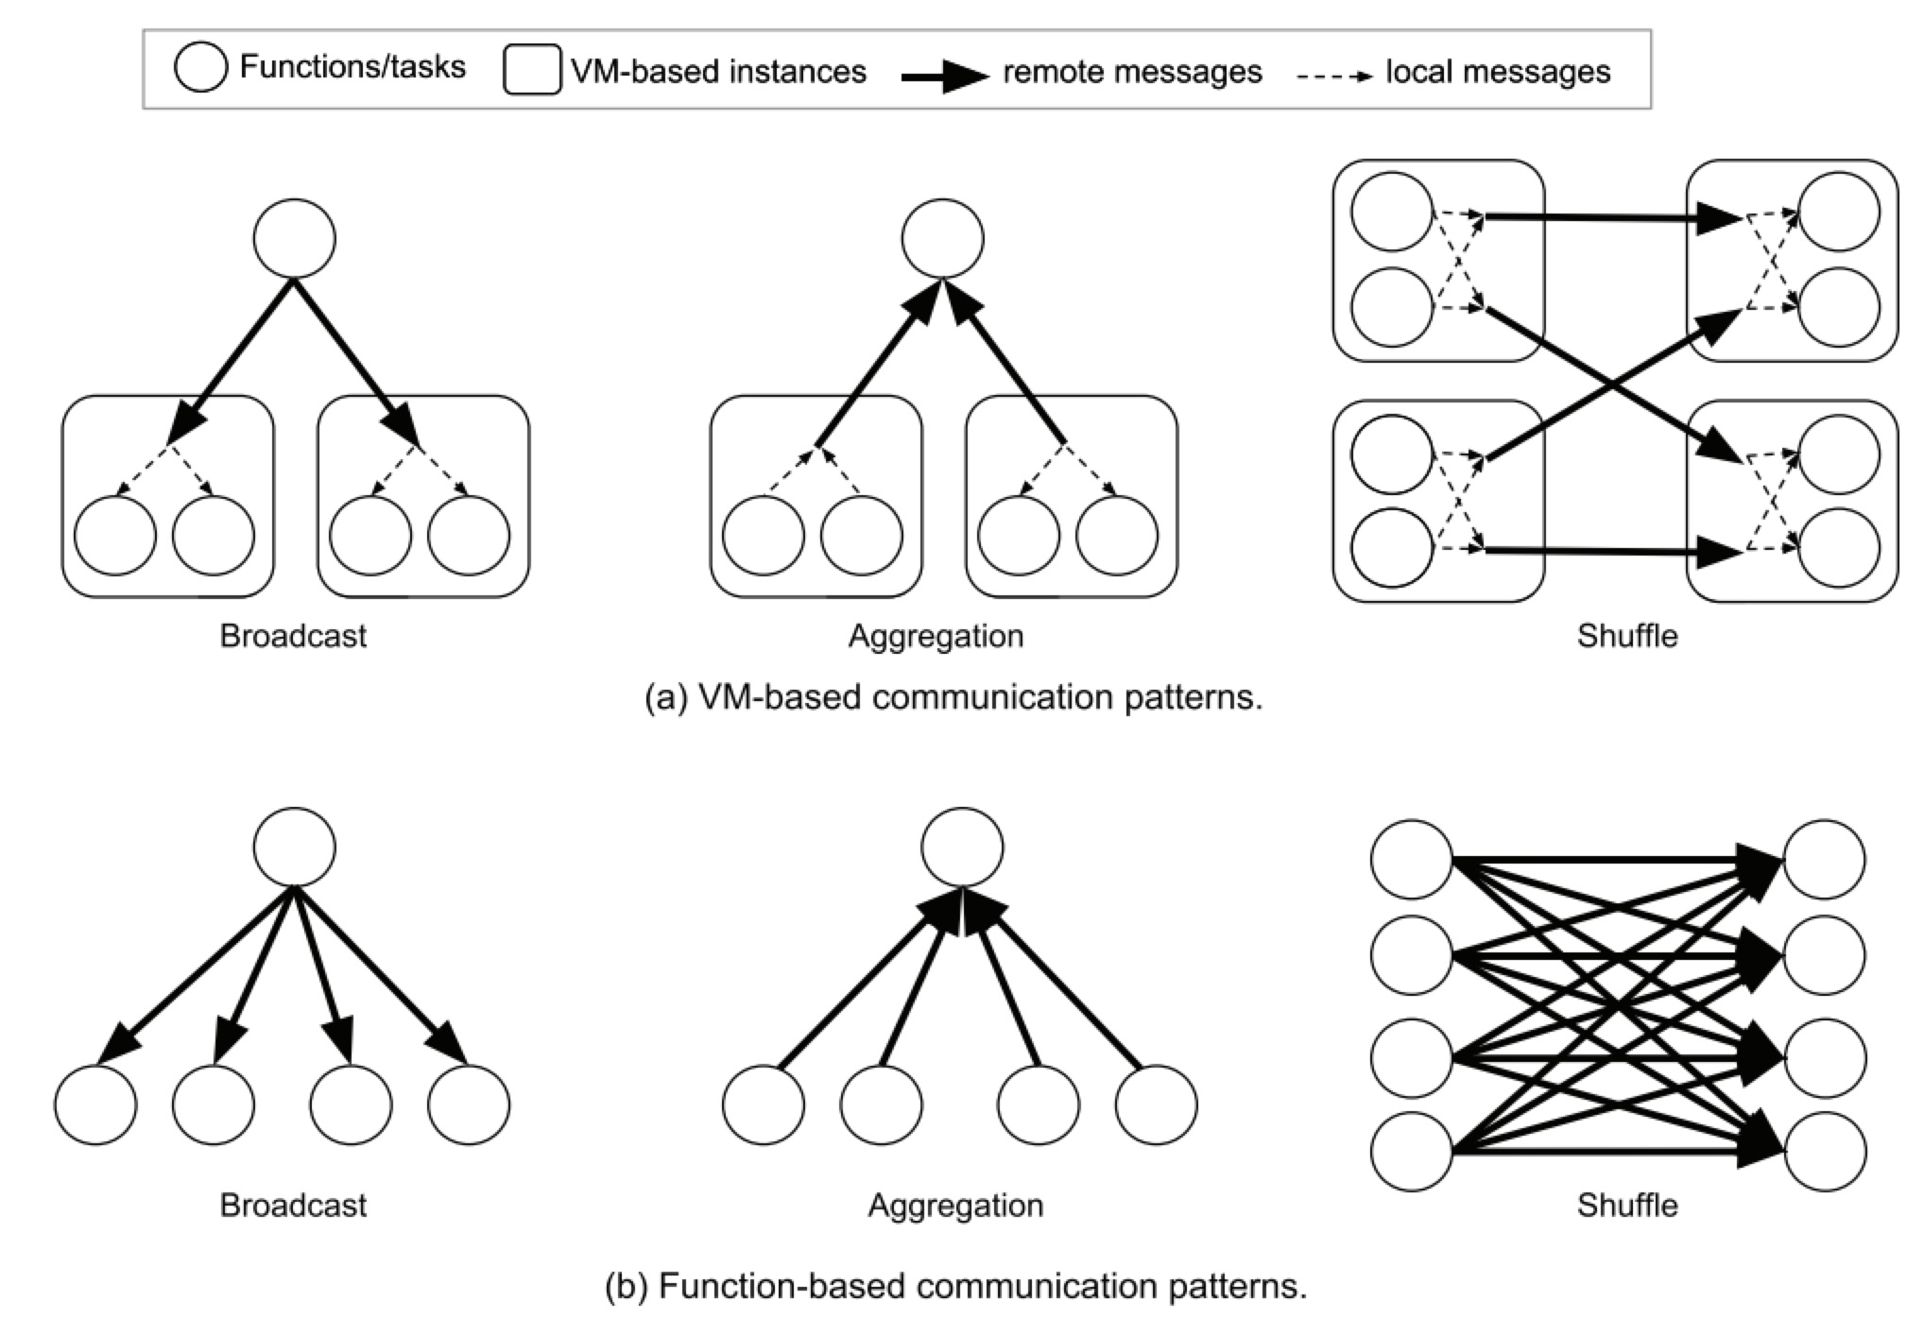
Poor performance on communications
Most common communications patterns
Broadcast, Aggregation, Shuffle - Machine Learning, Big Data analytics

Slide 27
Communication Complexity
K: the number of functions per VM(10 ~ 100)
VM-based Function-based
Broadcast O(N) O(N x K)
Aggregation O(N) O(N x K)
Shuffle O(N2) O((N x K)2)

Slide 28
Predictable Performance
Unpredictable cold start latency
Start a cloud function
Initialize the software environments(e.g: library)
Application-specific initialization in user code
2. Variability in the hardware resources
Tradeoff - the cloud provider desire to maximize the use of their resources and predictability.

Slide 29
What Serverless Computing Should Become

Slide 30
What Serverless Computing Should Become
Abstraction Challenges:
Resource requirements
Data dependencies
System Challenges:
High-performance, affordable storage
Minimize startup time:
Scheduling and starting resources to run cloud functions
Downloading the application software environment
Loading and initializing data structure and libraries
Notes:
Now that we’ve explained today’s serverless computing and its limitations, let’s look to the future
to understand what serverless computing should become and those challenges we will face in the future. Researchers have already begun to
address issues
Resource Requirements:
Today’s serverless offers developers specifies memory and execution time limit.
Hinders users who want more control
1.enable developers to specify requirements explicitly
2.having cloud provider infer resources
Data Dependencies:
Cloud function has no idea of the data depen between the cloud functions
This ignorance can lead to suboptimal placement that could result in inefficient communication
1.allow an application to specify its computation graph, enable better placement that minimize communication
Storage:
Application are limited by the speed and latency of the storage system used to transfer state between cloud functions. While their capacity demands vary, all need such storage to maintain application state during the application lifetime
1.build a distributed in-memory service with an optimal network stack that ensures microsecond-level latency
RAMCloud, FaRM
Startup:
1.dynamically and incrementally load the libraries as they are invoked by the application
2.

Slide 31
What Serverless Computing Should Become
Computer architecture challenges:
Hardware Heterogeneity, Pricing and Ease of Management:
Alas, the x86 microprocessors that dominate the cloud are barely improving in performance. In 2017, single program performance improvement only 3%. Assuming the trends continue, performance won’t double for 20 years. Similarly, DRAM capacity per chip is approaching its limits; 16 Gbit DRAMs are for sale today, but it appears infeasible to build a 32 Gbit DRAM chip.
Serverless could embrace multiple instances type.
The cloud provider could select language-based accelerators and DSAs automatically.
Notes:
1.For functions written in high-level scripting language like js or py, hardware-software co-design could lead to language-specific custom processors.
2.Domain Specific Architectures. DSAs are tailored to a specific problem domain and ofer significant performance and efficiency gains for that domain.

Slide 32
What Serverless Computing Should Become
Summary and Predictions:
We expect new storage services to be created that expand the types of applications that run well on serverless computing.
We will see much more heterogeneity of computer hardware for serverless computing.
We expect serverless computing to become simpler to program than serverful computing.
The cost of serverless computing should be lower than that of serverful computing.
…….

Slide 33
Conclusion

Slide 34
What we’ve introduced today
Based on two papers : OpenLambda and Berkeley
Serverless Computing -- How it came into being
Runtime sharing -- How it works
Limitations
What serverless computing should become

Slide 35
Bonus
Berkeley paper gives high evaluation on serverless computing

Slide 36
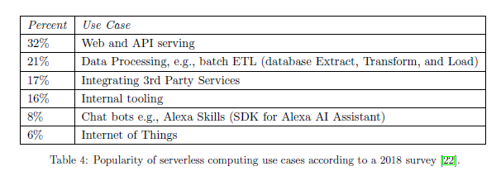
Serverless computing today

Slide 37
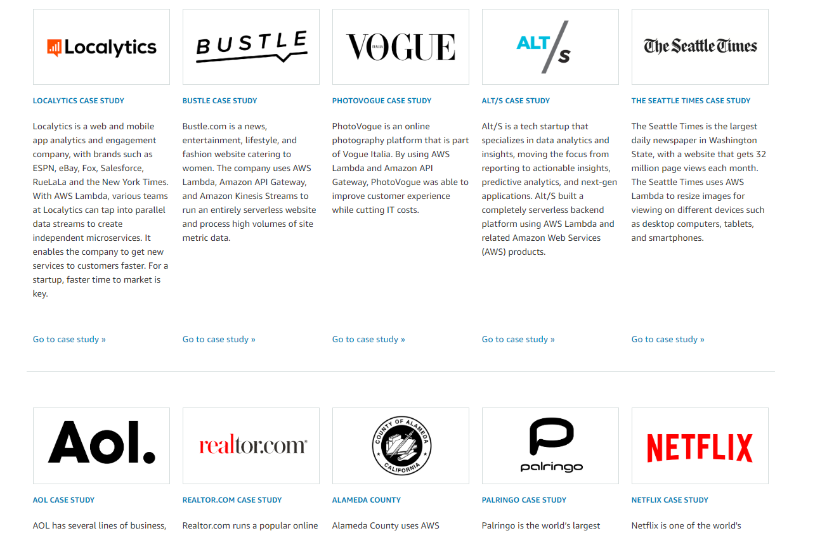
Serverless Computing User Cases

Slide 38
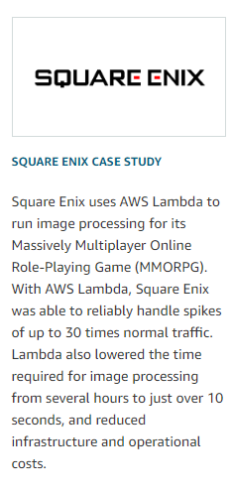
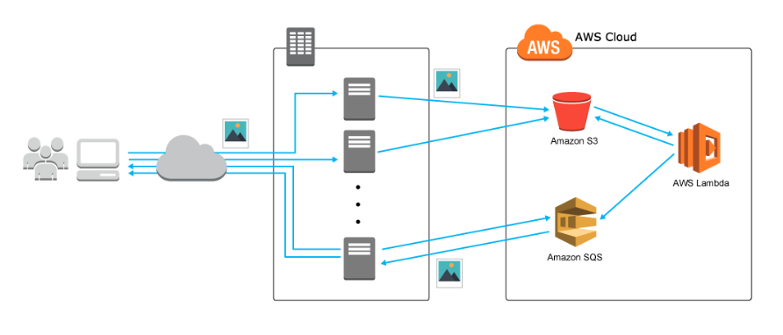
Serverless Computing User Cases
When a screenshot is taken, the binary image data are first uploaded to Amazon Simple Storage Service (Amazon S3). An Amazon S3 event then triggers AWS Lambda for image processing. After this, queues containing the binary image data output from Amazon Simple Queue Service (Amazon SQS) are imported into the on-premises servers to save the processed image data.

Slide 39
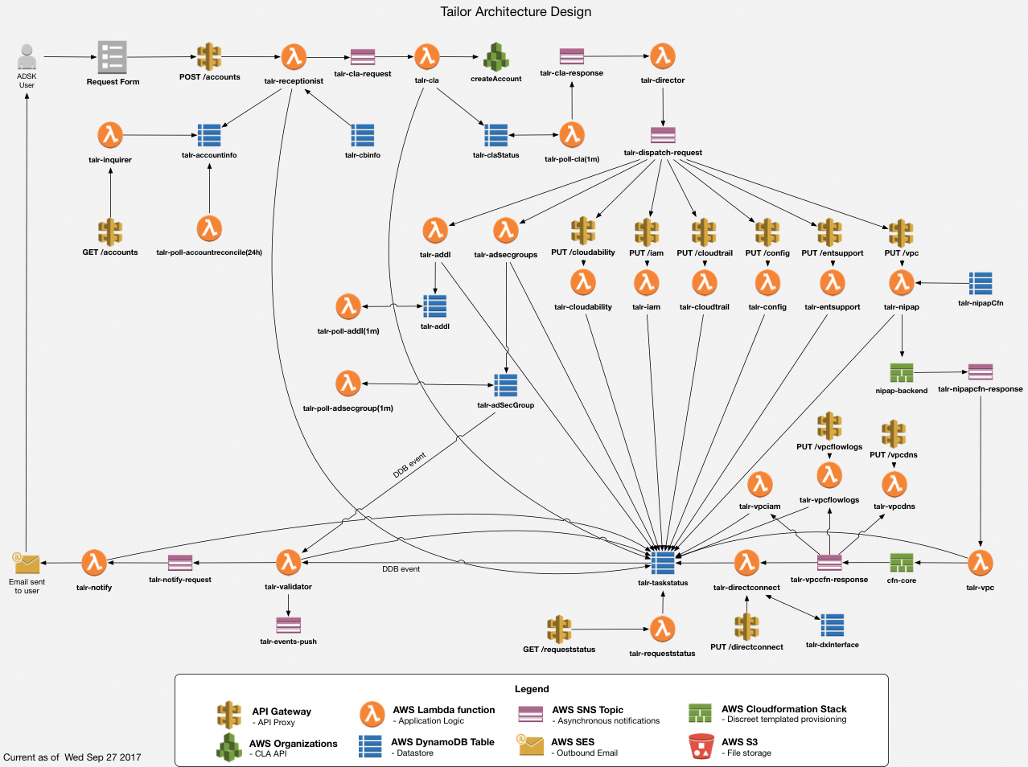
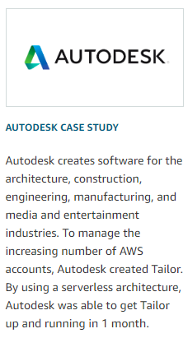

Slide 40
Skyrocket
We think serverless computing is a powerful technology that will have a bright future
We believe development in serverless computing could bring breakthroughs in cloud computing
There are also certain limitations / obstacles
Stateless -- whether it will apply to all
We feel more excited on our own FaaS project!

